Slide 1

Right care, right person
Briefing Pack
March 2024
A partnership approach
to ensure the right response
by the right professional

Slide 2

WHAT IS RIGHT CARE, RIGHT PERSON?
“
RCRP is an operational model that provides guidance on the way the MPS responds to health related calls.
RCRP is aimed at making sure the right agency deals with health-related calls, instead of the police being the default first responder where there is a concern about a person’s physical or mental health.
RCRP CONTEXT
“
2020
RCRP introduced and piloted by Humberside in 2020 in a phased approach
May 2023
MPS Commissioner confirms to London’s Health & Social Care providers that the MPS will introduce RCRP by Autumn 2023
Sept 2023
MPS RCRP policy written, legal advice received and formally signed off by MPS Management Board
Feb 2023
Letter from Home Secretary announcing the intention for a National Partnership agreement to implement RCRP
July 2023
RCRP National Partnership Agreement signed by Home Office, NPCC, APCC, CoP, NHS, and Dept. for Health & Social Care
1st
Nov 2023
MPS operational go-live for RCRP

Slide 3




THE FOUR PILLARS OF RCRP
The MPS RCRP policy applies to four health-related pillars only
PILLAR 1:
MEDICAL SUPPORT
When a member of the public
requests medical support
Incidents in which police are
already present when medical
support is requested or required
RIGHT CARE, RIGHT PERSON
PILLAR 3:
WALK-OUT / AWOL
When a person has walked out
from a healthcare setting, has
abandoned medical care / treatment
or is absent without leave (AWOL)
from mental health services
Pillar 1
Medical Support
Pillar 2
Concern
for Welfare
Pillar 3
Walk Out/ AWOL from Health-care
Pillar 4
Transport under Section 136
PILLAR 2:
CONCERN FOR WELFARE
When a member of the public
or partner agency reports a
concern for the welfare of a
person and requests that
police visit the individual
PILLAR 4:
TRANSPORT UNDER S136
Transporting a person detained
under s136 to a health based
place of safety and undertaking
a timely handover to a medical
professional
Ensuring that people with health / social care needs
are responded to by the right person with the right
skills, training and experience to meet their needs

Slide 4
OVERVIEW SINCE GO-LIVE
 | Nov 2022 | Dec 2022 | Oct 2023 | Nov 2023 | Dec 2023 | Jan 2024 | Feb 2024 (Up to 25th)
Total Incidents | 34,613 | 34,576 | 33,635 | 28,786 | 28,005 | 28,762 | 24,138
Deployments | 14,220 | 14,195 | 12,639 | 7,760 | 7,616 | 8,370 | 7,005
Deployment Rate | 41% | 41% | 38% | 27% | 27% | 29% | 29%

Slide 5
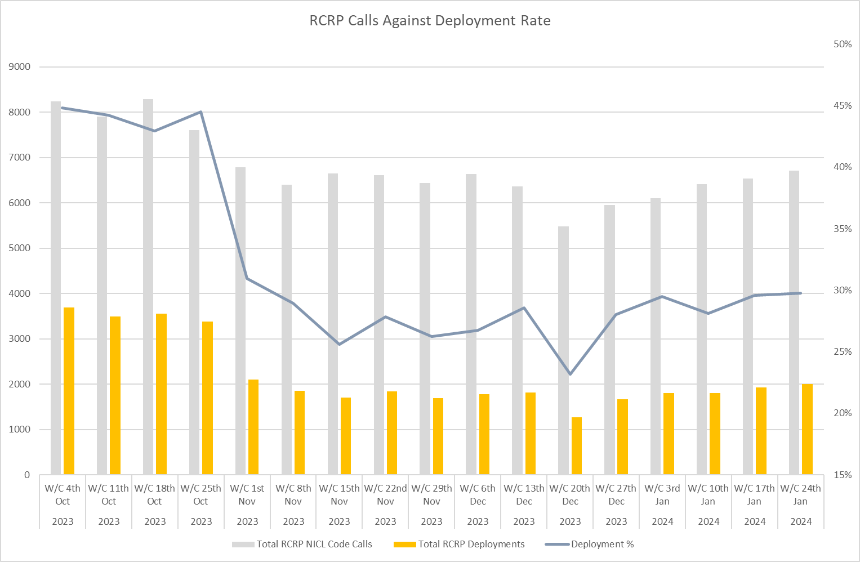
Weekly RCRP related demand and deployment volumes pre and post go live of RCRP

Slide 6
RCRP categories by incident and deployment volumes (February)
Comparative RCRP categories by volume and deployment percentage for February

